Slide 1

Project: Bank Marketing Campaign
Name: Supin Hooda
Batch Code: LISUM25
Specialization: Data Science

Slide 2

Problem Statement Dataset
Agenda
EDA
Recommendations

Slide 3
Problem Statement
ABC Bank wants to sell it's term deposit product to customers and before launching the product they want to develop a model which help them in understanding whether a particular customer will buy their product or not (based on customer's past interaction with bank or other Financial Institution). This is an application of the organization’s marketing data.
Objective: Build a Classification ML model to shortlist customers who are most likely to buy the term deposit product. This would allow the marketing team to target those customers through various channels.

Slide 4
bank-additional-full.csv: 20 inputs (+1 target variable) and 41118 observations
https://archive.ics.uci.edu/ml/datasets/Bank+Marketing
Dataset
Assumptions:
‘Duration’ feature is dropped as suggested in the dataset
description
A frequently occurring missing value ‘unknown’ is considered
as another category for the categorical features.
Duplicate rows were deleted from the dataset.

Slide 5
EDA

Slide 6
EDA
1. Univariate Analysis

Slide 7
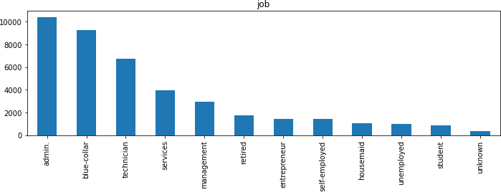
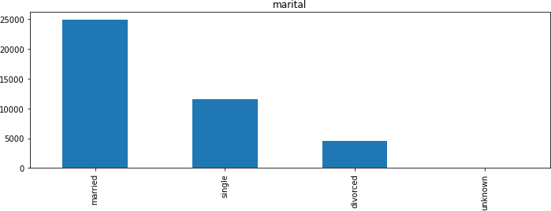
Jobs Distribution
Administrative staff and technicians are the most common job roles.
Marital Status and Subscription
Married customers have a higher subscription rate.

Slide 8
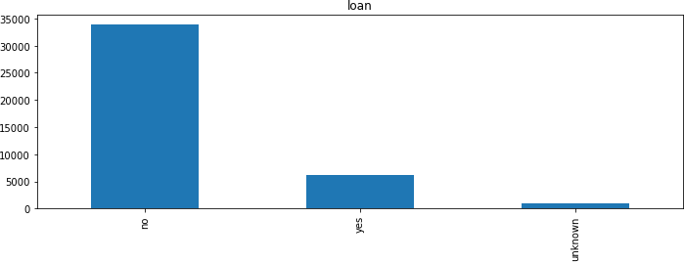
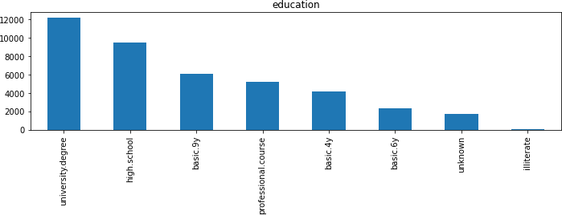
Education Level Distribution
Most customers are university graduates, followed by high school graduates.
Personal Loan Distribution
Majority of customers do not have a personal loan.

Slide 9
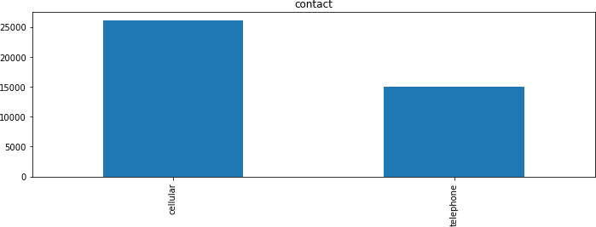
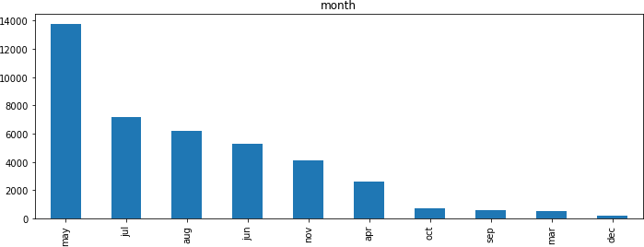
Contact Month Distribution
May has the highest number of contacts.
Communication Type
Cellular communication is more prevalent than telephone communication.

Slide 10
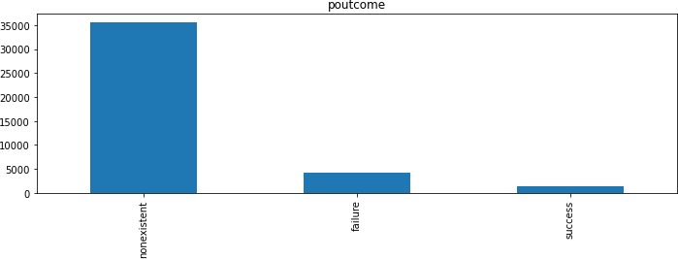
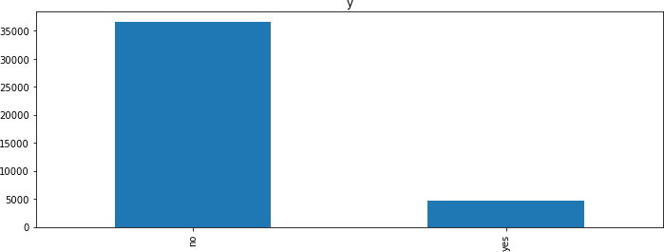
Previous Campaign Results
A significant portion of the dataset does not have information on whether the previous marketing campaign succeeded or failed.
Subscription Rate in Previous Campaign
In the previous campaign, the percentage of people who subscribed to the deposit is less to those who did not.

Slide 11
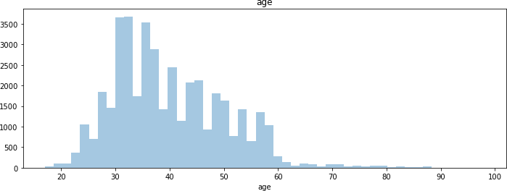
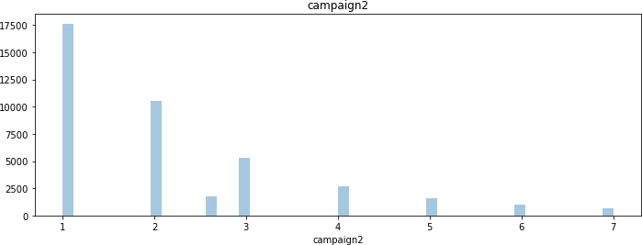
Number of Follow-ups Distribution
The number of follow-ups was relatively low in the previous campaign.
Age Group Distribution
The age group of contacted customers is mostly between 20 to 60.

Slide 12
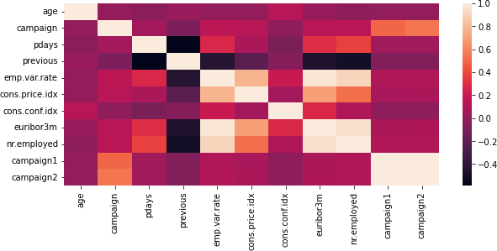
Correlation map

Slide 13
EDA
2. Bivariate Analysis

Slide 14
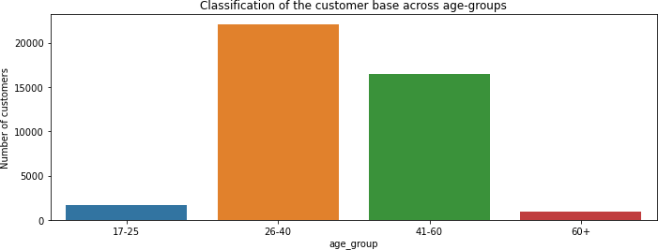
Age-Group Analysis
Most of the customer’s belong to the age-groups of 26-40 and 41-60 years

Slide 15
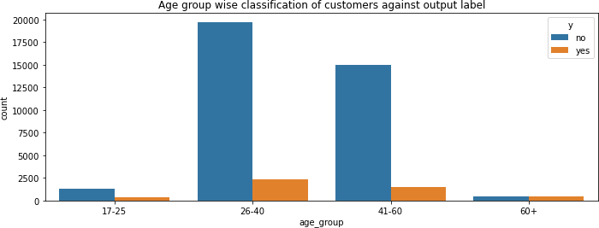
Age-Group Analysis
In the age-groups of 26-40 and 41-60 years, the majority of people did not subscribe to the term deposit plan.

Slide 16
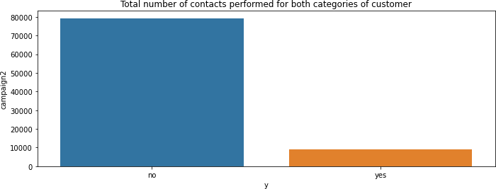
Campaign Contacts vs. Subscription
When a greater number of contacts are made, customers tend not to subscribe to the term deposit plan.

Slide 17
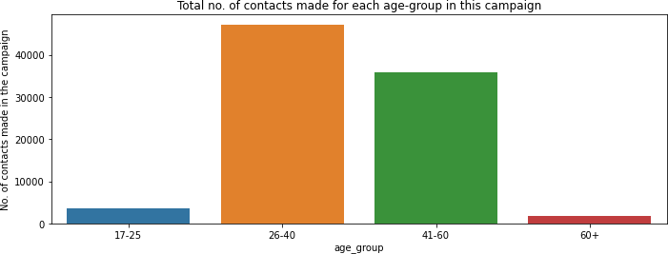
Age-Group and Campaign Contacts
The 26-40 and 41-60 age-groups witness the majority of contacts in this campaign, suggesting these as target groups for the bank.

Slide 18
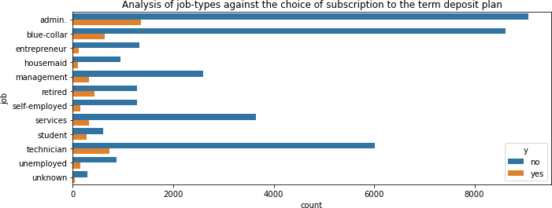
Job Analysis and Subscription
'Admin,' 'blue-collar,' and 'technician' are prominent jobs, with many customers in these roles rejecting the term deposit plan.

Slide 19
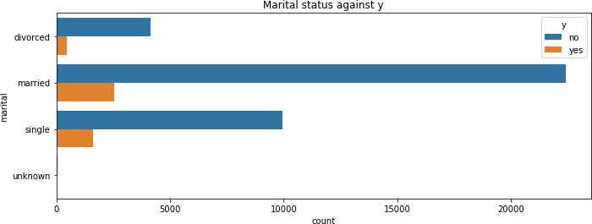
Marital Status Analysis
Married customers are the majority, and comparatively, more of them have taken the term deposit.

Slide 20
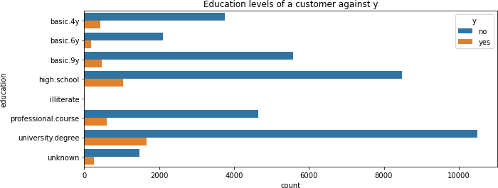
Education Level Analysis
Customers with a university degree are more likely to subscribe to the term deposit.

Slide 21
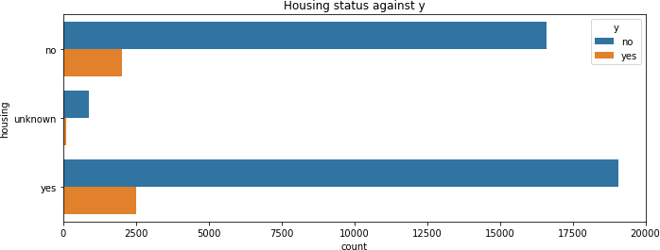
Housing Status Analysis
Customers with a housing loan are more likely to subscribe to the term deposit.

Slide 22
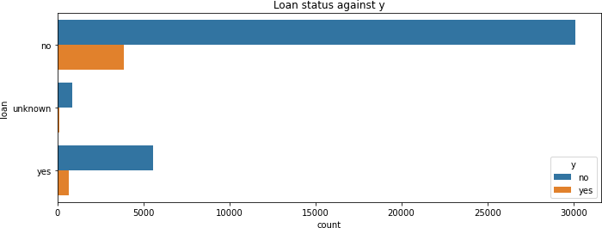
Loan Status Analysis
Customers with a personal loan are comparatively less likely to subscribe to the term deposit.

Slide 23
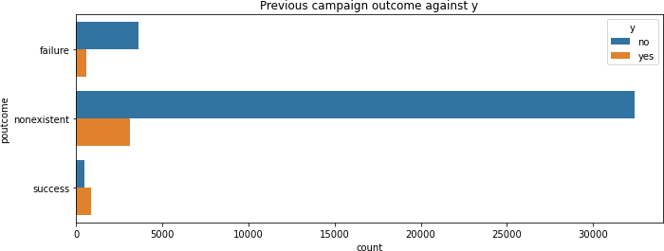
Previous Campaign Success
The success rate of the previous marketing campaign has resulted in more people subscribing to the term deposit.

Slide 24
Optimal Timing:
May has proven to be the most effective month for customer contact. Consider focusing marketing efforts during this period for maximum impact.
Enhanced Customer Engagement:
Increase the frequency and duration of contacts made to each customer. This extended engagement may lead to improved subscription rates.
Targeted Education Levels:
Place a strategic emphasis on university graduate students and high school degree holders. Tailor marketing strategies to resonate with these educational demographics.
Strategic Age-Group Targeting:
Concentrate marketing efforts on the age-groups of 26-40 and 41-60, as these segments demonstrate a higher proportion among customers. These age-groups present a lucrative target for the marketing team.
Occupational Focus:
Direct marketing efforts towards administrators and technicians. These professional groups show potential for increased subscriptions and warrant additional focus in the campaign strategy.
Recommendation to improve campaign

Slide 25
Logistic Regression
Naïve Bayes
Decision Tree
Random Forest
Ada Boost
Next Steps: Hyperparameter Tuning and Model Evaluation
Perform hyperparameter tuning to optimize model performance.
Evaluate each model's performance using metrics such as accuracy, precision, recall, F1 score, and ROC-AUC.
Identify the best model and important features through rigorous evaluation.
Recommended Models for Dataset

Slide 26
Logistic Regression
Naïve Bayes
Decision Tree
Random Forest
Recommended Model for this dataset
Hyper parameter tuning and model evaluation will be performed in order to determine the best model and the important features

Slide 27
We have transformed categorical features such as 'job', 'marital', 'education', 'default', 'housing', 'loan', 'contact', 'month', 'day_of_week', 'poutcome', 'campaign2', and 'y' into numerical representations. This conversion facilitates the integration of these features into our models.
To ensure optimal convergence in gradient descent, we have applied feature scaling to all features using StandardScaler(), promoting a global minimum in the optimization process.
Our dataset has been divided into training and testing sets utilizing the train_test_split() function.
We have employed five recommended models, namely Logistic Regression (Linear), Decision Tree (Linear), Naïve Bayes (Linear), Random Forest (Ensemble), and Gradient Boosting (Boosting), to train our dataset.
For the evaluation of our models, we have utilized cross-validation testing with 10 folds, using accuracy as the key metric. This approach provides a robust assessment of the performance of each model across different subsets of the dataset.
Model Building

Slide 28
Accuracy results
Model | Accuracy
Logistic Regression | 84.21%
Decision Tree | 27.99%
Naïve Bayes | 82.05%
Random Forest | 47.27%
Gradient Boosting | 53.42%
From all the above Models, Logistic Regression performed the best with an accuracy of 84.21% therefore I recommend this model for production purpose

Slide 29
Given the superior performance of Logistic Regression, we conducted hyperparameter tuning to identify the optimal features. The model was executed using the following set of parameters.
Hyper parameter tuning
The best parameters values were identified as
Parameter | Values
C | 0.1623776739188721
penalty | 'l1'
Solver | liblinear
max_iter | 80
With Hyperparameter tuning the accuracy increased from 84% to 89.65%.

Slide 30
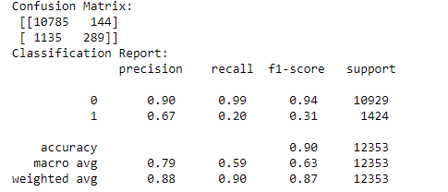
Confusion matrix results tell us that we have 10785 + 144 Correct predictions and 1135+289 incorrect
2. Classification report shows precision as 90% which is the ability of a classification model to identify only the relevant data points, that is in this case people who would be subscribing to the term deposit is correctly classified.
Confusion matrix and classification report

Slide 31
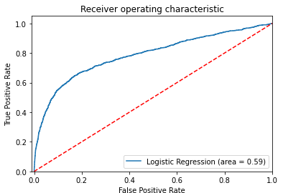
AUC-ROC
curve
An ROC curve is a graph showing the performance of a classifier. ROC is a probability curve plotted with True Positive Rate (also called Recall or Sensitivity) on the y-axis against False Positive Rate (also called as Precision) on the x-axis. The Area Under the Curve (AUC) is the measure of the ability of a classifier to distinguish between classes and is used as a summary of the ROC curve. The higher the AUC, the better the performance of the model at distinguishing between the positive and negative classes.

Slide 32

Thank You

